Slide 1
Welcome
BSCS-3

Slide 2
OUTLINE
What are Sorting Techniques
Importance
Working Process of Bubble, Selection and insertion Sort
Activity
Multidimensional Array
Sorting Program

Slide 3
What are sorting Algorithms
“Sorting algorithms are a set of instructions or techniques used to arrange data in a specific order, usually in ascending or descending order”

Slide 4
Importance
Easy Data Access:
Sorted data is easier to find and use, making searches faster.
Boosts Efficiency:
Many tasks work better with sorted data, like searching and merging information.
Simplifies Problem Solving:
Sorted data helps solve problems faster, like finding duplicates.
Saves Memory:
Some sorting methods use less memory, which is helpful in limited storage environments.

Slide 5
techniques
Bubble Sort | Selection Sort | Insertion sort
Simple but inefficient for large data; repeatedly swaps adjacent elements if they are in the wrong order. | Divides the list into sorted and unsorted parts; repeatedly selects the smallest (or largest) element from the unsorted part and moves it to the sorted part. | Builds the sorted list one element at a time by inserting each new element into its correct position among already sorted elements; efficient for small datasets

Slide 6
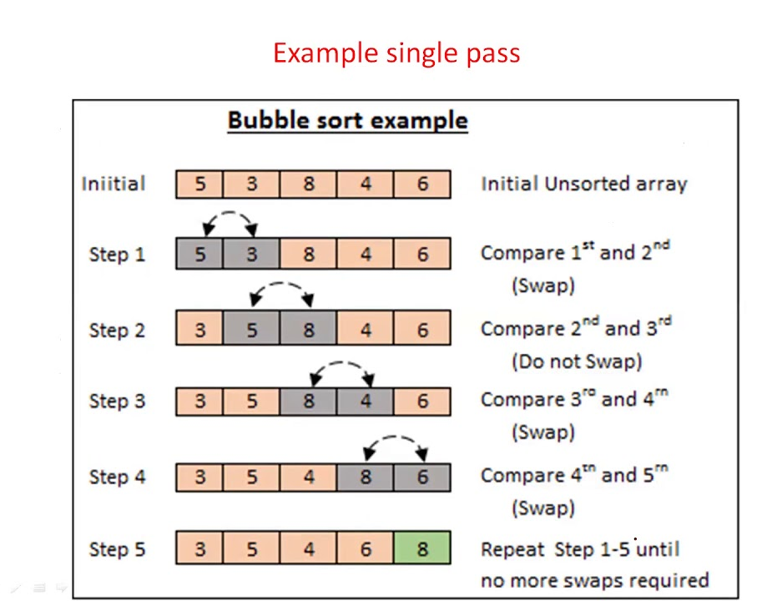
Bubble Sort:

Slide 7
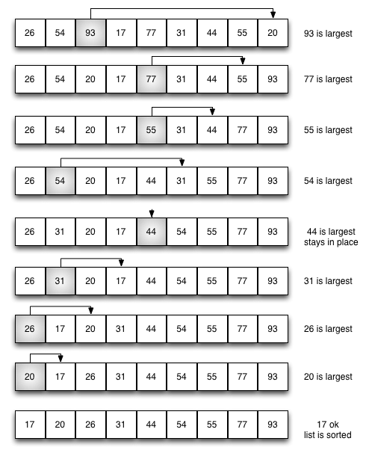
Selection sort:

Slide 8
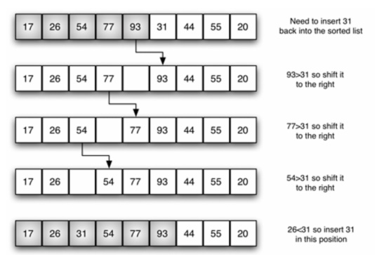
Insertion Sort

Slide 9
Activity
int array[] = {1, 2, 3, 4, 5, 6, 7, 8, 9};
int array[] = {5, 3, 8, 3, 5, 6, 1};

Slide 10
Multidimensional Array
“A Multidimensional array is essentially an array of arrays. It allows you to store data in a structured, table-like format with rows and columns. The most common type of multidimensional array is the 2D array (two-dimensional)”

Slide 11
Syntax+code:
#include <iostream>
using namespace std;
int main()
{
cout << "Try programiz.pro";
Int array[4][4]={{1,2,5,7},{8,0,4,2},{6,9,10,6},{1,4,7,3}};
for(int i=0;i<4;i++){
for(int j=0;j<4;j++){
cout << array[i][j]<<" "; } cout<<"\n";}
return 0;}

Slide 12

Questions?

